Slide 1
Chapter 5: Dynamic Analysis-Test Design Techniques
Software Testing
State Transition Testing

Slide 2
State Transition Testing
Motivation:
Current input
History of execution or events or inputs
State Transition Testing:
Black box testing technique
Based on theory of finite state machine
State is a particular situation where a system can be.
Change in the state of the application under varying input.
State : has certain Attributes and behaviors
Transition is movement of one valid state to another valid state.
Example: 1. Word Processor ( States: Open, Close)
2. ATM to Withdraw money

Slide 3

State Transition Testing
State transition testing exhibits:
- Various states of scenario/system
- Possible transitions
Certain inputs to the System Under Test(SUT)
- Change the state of SUT
- Produce outputs
Representation is called State transition diagram(STD)
Normally STD shows all the valid transitions
STD consists of pair of transition between 2 states
Pair is missing btw two states than missing transitions is/are called Invalid Transitions

Slide 4
State Transition Testing – Important Points
Verify
Different States
Transaction
Goal
Valid States
Invalid States
Significance
To cover sequence of the states
Point 1
Point 2
Point 3

Slide 5
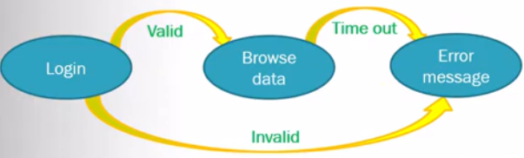
State Transition Testing – Important Points
Example:
Analysis:
Event cause the software to transition from one state to another and
perform transitions
Conditions decide the transition path

Slide 6
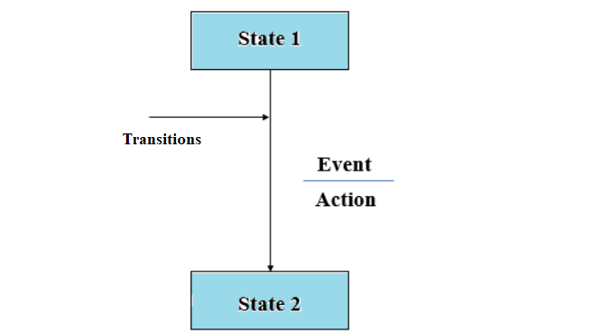
State Transition Diagram
There are 4 main components.
1) States
2) Transition
3) Events
4) Actions

Slide 7
Design State Transition
Two ways
State Transition Diagram
- States are shown in boxed texts
- Transition is represented by arrows.
- It is also called State Chart or Graph.
- It is useful in identifying valid transitions.
State transition table
- Shows relationships between all states and events
- STT consist of four columns—Current State, Event, Action, and Next State.
- States can be listed on the left side
- Events can be on the top.
- Each cell in the table shows the state of the system after the event has occurred.
- It is useful in identifying invalid transitions.

Slide 8
When to use State Transition Testing?
Finite set of input values.
Sequence of events
Proper handling of a particular event
Real time systems

Slide 9
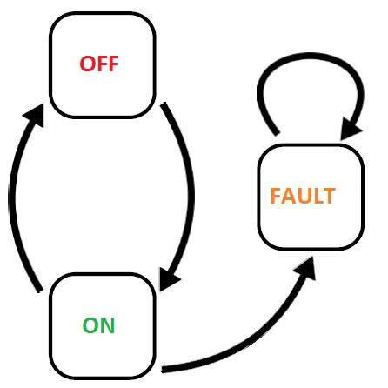
State Diagram-Example1 Light Switch
States On > Off > On

Slide 10
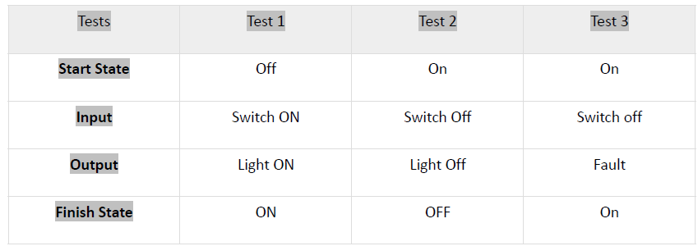
State Transition Table Example 1
Possible scenarios that need to be tested.

Slide 11
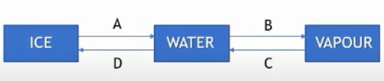
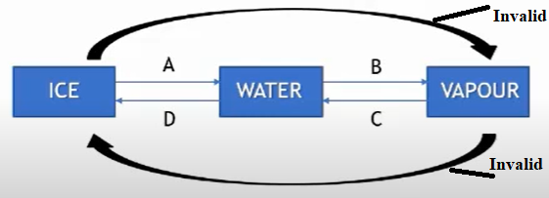
STT Example 2-Water
State transition diagram:
Invalid transition generally not shown in STD
Diagram with invalid transitions

Slide 12
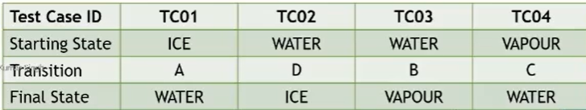
STT Example 2-Water
State transition table
Same diagram in tabular form

Slide 13
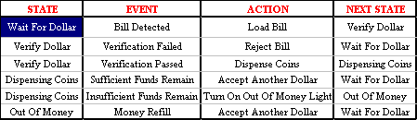
STT Example 3-Dispensing machine

Slide 14
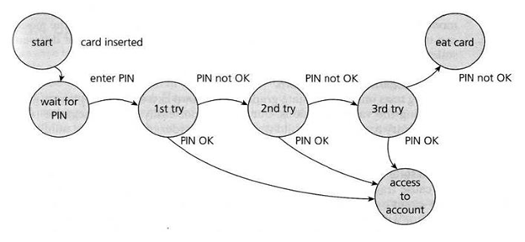
STT – Example 4
Example below is entering a Personal Identity Number (PIN) to a bank account. The states are shown as circles, the transitions as lines with arrows and the events as the text near the transitions.
States: S1:Start, S2:Wait for Pin, S3: 1st try, S4: 2nd Try, S5: 3rd Try, S6: access to account, S7: eat card
Events: Event1:Card inserted, Event 2: enter Pin, Event 3: Pin OK, Event 4: Pin not OK Actions : (not shown in the above example

Slide 15
Typical Test Cases- Example 4
Test Case 1:
Where the correct PIN is entered the first time.
Test Case 2:
A second test (to visit every state) would be to enter an incorrect PIN
each time, so that the system eats the card.
Test Case 3:
A third test we can do where the PIN was incorrect the first time but
OK the second time.
Test Case 4:
Where the PIN was correct on the third try.

Slide 16
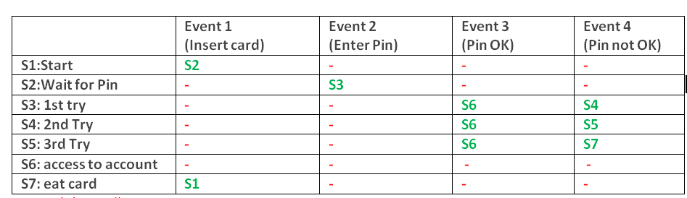
STT-Testing Invalid Transitions Example 4
- STT shows relationships between all states and events
- Resulting states and output
- To see both valid and invalid, a State Table can be used.
-Invalid or Null Transitions are represented as ‘-‘ in red in the table above

Slide 17
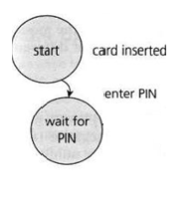
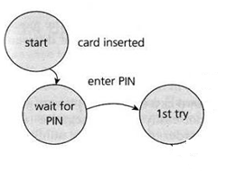
Chow’s Coverage (Coverage of tests)
Chow's switch coverage describes how you cover a state transition model
“Switch” here is state in between start and end state
0-switch coverage
- Coverage of all individual transitions
-i.e. (no of exercised single-transitions in sequence ) x 100 (total no. of single-transitions in a sequence)
1-switch coverage
- coverage of transition pairs
-i.e (no of exercised two-transitions in sequence )* 100
(total no. of two-transitions in a sequence)
2-switch coverage
- coverage of transition triples
……….. N switch coverage.

Slide 18
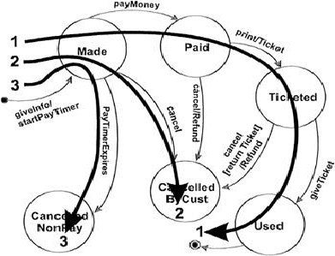
Creating Test Cases for STD
All states are "visited" at least once
Three test cases shown below
Generally this is a weak level of test coverage.
Notes:
Make a reservation
Provide information including departure and destination cities, dates, and times.
A reservation agent uses that information to make a reservation.
At that point, the Reservation is in the Made state.
The system creates and starts a timer.
If this timer expires before the reservation is paid for, the reservation is cancelled by the system.

Slide 19
Creating Test Cases
All events are triggered at least once
Note that the test cases that cover each event can be the same as those that
cover each state.
This is a weak level of coverage.

Slide 20
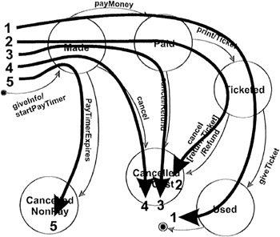
Creating Test Cases
All transitions are exercised at least once
Provides a good level of coverage
Generally the one recommended

Slide 21
STT Advantages and Disadvantages
Advantages:
Helps in understanding the behaviour of the system
Covers all the conditions.
Provide tabular representation
Tester can verify that all the conditions are covered, and the results are captured.
It lists all possible state-transition combinations, not just the valid ones.
Disadvantages:
Not reliable when system is not finite system
Transition tables becomes very large when states and events increases.

Slide 22
Thank you

